Slide 1


Investment Portfolio Optimization using Knapsack Algorithm
Algorithmic approach to maximize returns and balance risk.
by DEEPANJALI SINGH (RA2311003010796)

Slide 2

Problem Statement
The key problem is how to optimize an investment portfolio within a limited budget to maximize returns while managing risk.
Description
1
Optimize portfolio to maximize returns
2
Identify profitable stocks
Manage risk within a budget
Use algorithms to find best combination
3
Balance risk and reward
4
Build portfolio aligned with goals
Help investors make informed decisions
Maximize returns without excessive risk
Notes:
The key problem we're addressing is how to optimize an investment portfolio within a limited budget to maximize returns while managing risk. The main objectives are to identify the most profitable stocks, implement an algorithmic approach to find the best stock combination, and balance risk and reward to build a well-optimized portfolio. Investors often face the challenge of selecting the right assets to achieve the highest possible returns while staying within their available funds and keeping overall risk exposure under control. Our goal is to develop a solution that helps investors make informed decisions and construct a portfolio that meets their financial goals and risk tolerance. By carefully analyzing the available options and applying advanced optimization techniques, we can help investors maximize their returns without taking on excessive risk.

Slide 3

Real-Life Scenario
Limited Capital
Inefficient Manual Selection
Investors face limited capital.
Manual selection is inefficient.
Automated Strategy
Automated strategy aids decision-making.

Slide 4




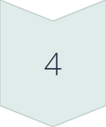
Algorithmic Technique Used
0/1 Knapsack Algorithm
Dynamic Programming (DP) approach.
Investment Cost
Each stock has investment cost (weight).
Expected Return
Each stock has expected return (profit).
Maximize Profit
Maximize profit without exceeding budget.

Slide 5





Implementation Details
Language
Data Structures
Input
C
Budget, stocks, cost, profit
Arrays, 2D DP table
Output
Selected stocks, max profit

Slide 6
Pseudocode
Input Data
1
Read budget, number of stocks, stock details.
2
Initialize DP Table
Create table dp[i][w], set dp[0][w] = 0.
Fill DP Table
3
Apply Knapsack logic.
4
Find Max Profit
Maximum profit at dp[n][total_budget].
Traceback
5
Find selected stocks.
6
Output
Print selected stocks.

Slide 7
Time Complexity Analysis
Complexity
Space Complexity
Efficiency
0/1 Knapsack (DP): O(N * W)
O(N * W)
DP reduces exponential time to polynomial time.
N: Number of stocks
N: Number of stocks
W: Budget
W: Budget

Slide 8
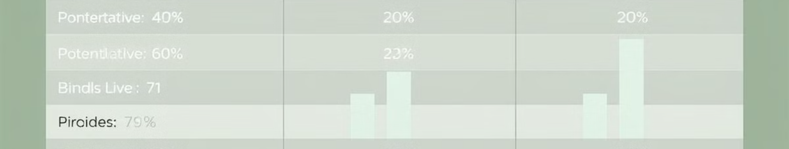
Outcomes & Results
Stock Name
Investment
Profit
Bajaj
₹35,000
₹14,000
Tata Motors
₹15,000
₹7,000
HDFC Bank
₹20,000
₹9,000
Infosys
₹30,000
₹15,000

Slide 9




Advantages & Future Scope
Automates Selection
1
2
Ensures Max Returns
Based on mathematical optimization.
Within budget.
Risk Assessment
Scalable
Balance risk and return.
4
3
For different datasets.

Slide 10

Conclusion & References
1
Optimizes Decisions
2
Maximum Profit
Knapsack Algorithm helps optimize investment decisions.
Ensures maximum profit within a given budget.
3
Structured Approach
Provides a structured, algorithmic approach.

